Slide 1


Predictive Modelling of Customer Bookings

Slide 2
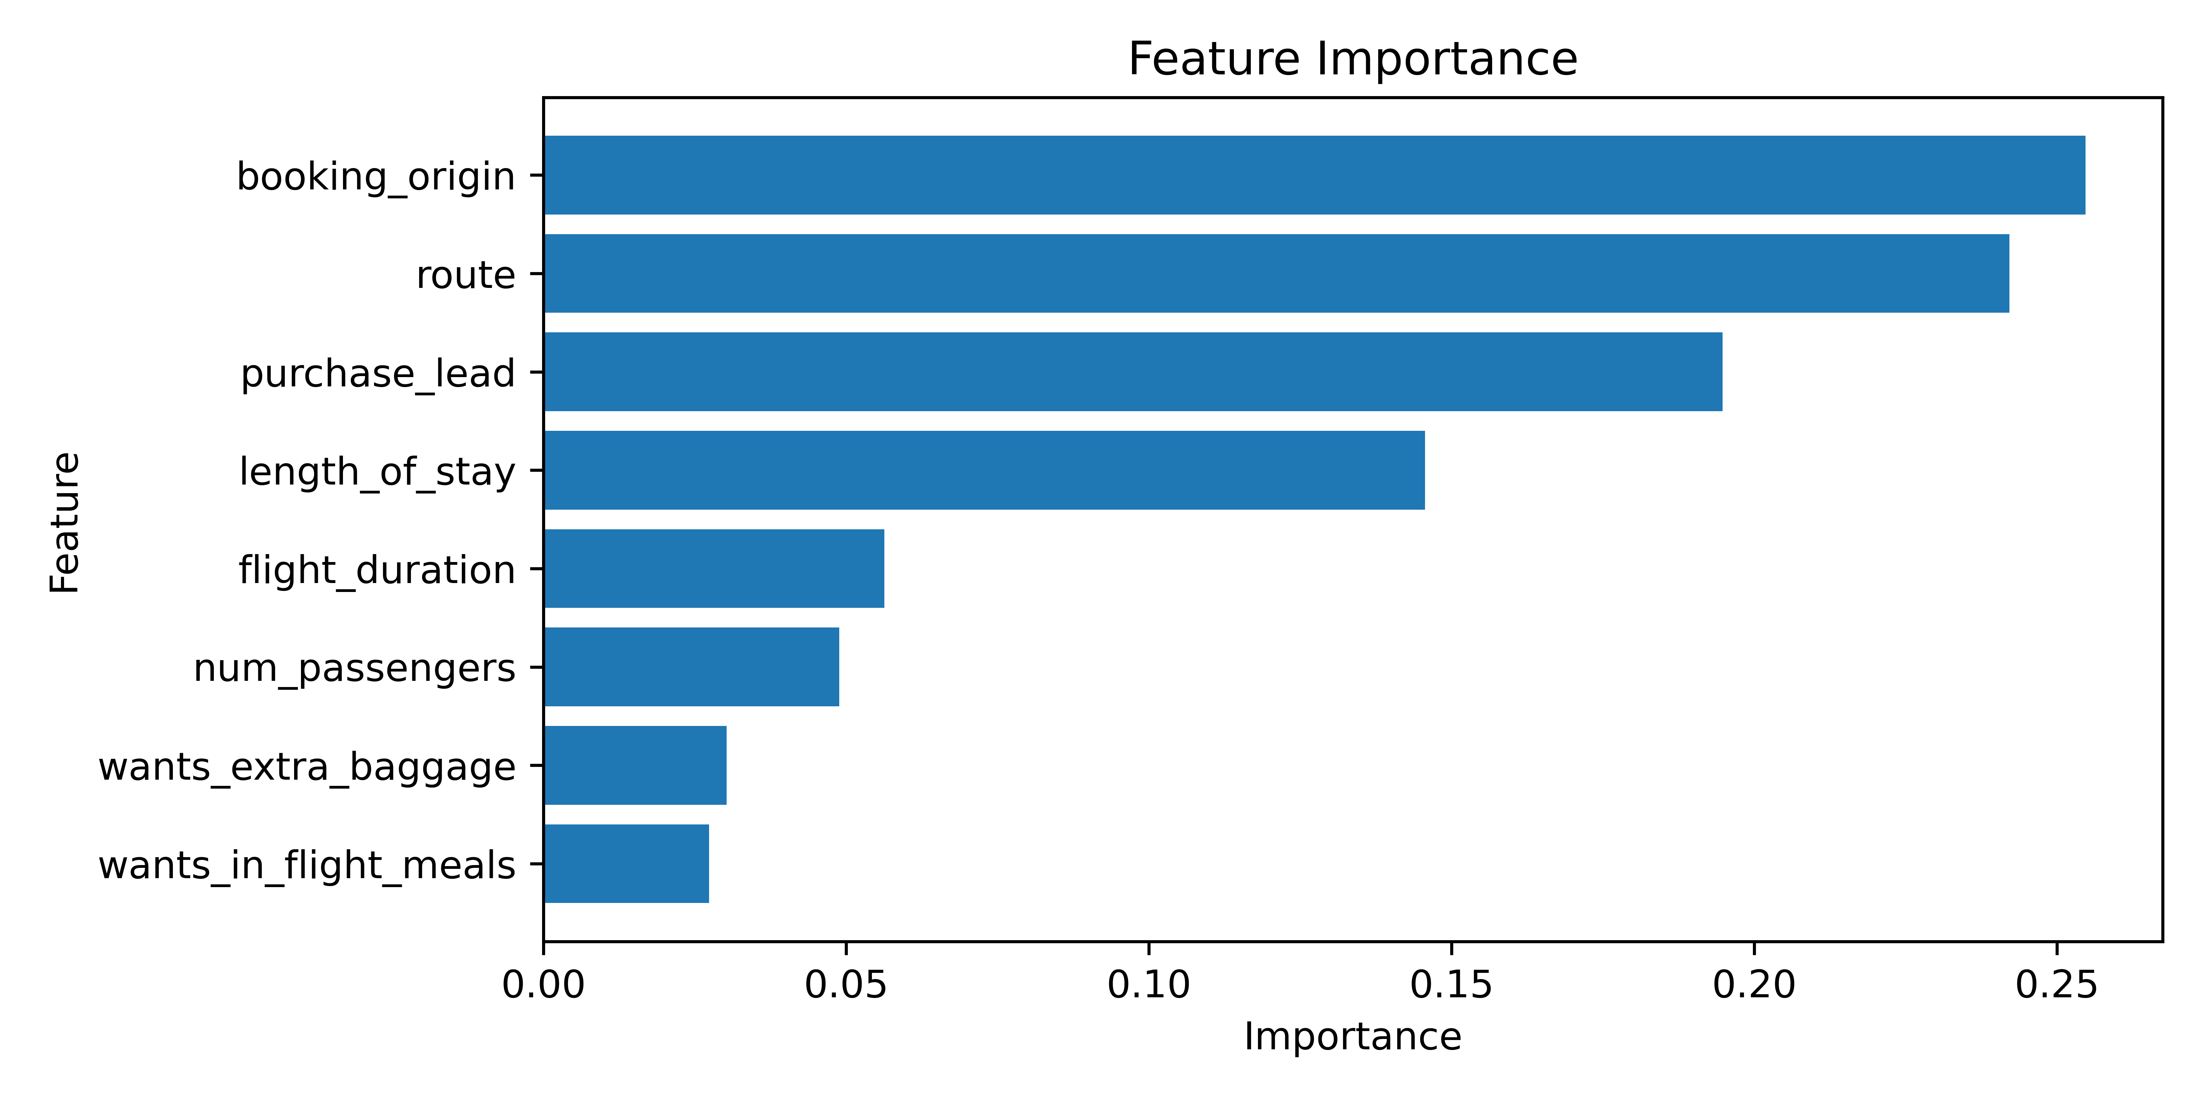
Key Features Influencing Customer Bookings
Trained a RandomForest Classifier:
Achieved an accuracy of 85%
AUC-ROC score of 0.78
High accuracy in predicting non-completions.
Robust performance in identifying bookings not completed.
Most important features in predicting customer bookings:
Country where booking is made.
Route of travel.
Proposed further steps:
Collecting additional data.
Addressing class imbalance for better predictions.

